Slide 1
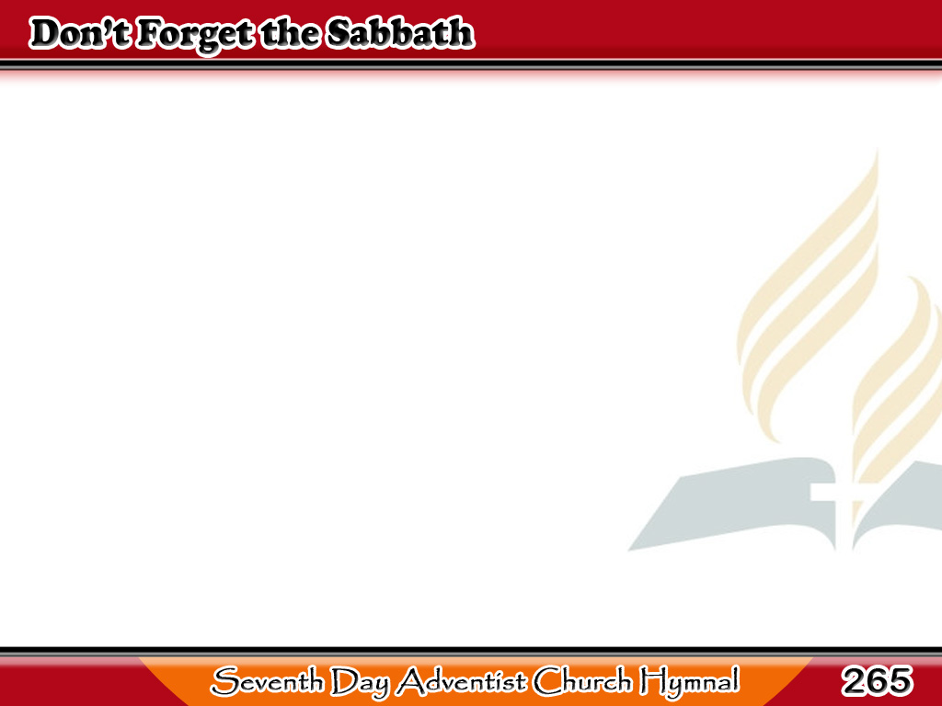
H’wag Kalilimutan ang Sabado
Don’t forget the Sabbath,
The Lord our God hath blest,
Of all the week the brightest,
Of all the week the best;
1/3

Slide 2
H’wag Kalilimutan ang Sabado
It brings repose from labor,
It tells of joy divine,
Its beams of light descending,
With heavenly beauty shine.
1/3

Slide 3
H’wag Kalilimutan ang Sabado
-Refrain-
Welcome, welcome,
ever welcome,
Blessed Sabbath day. (2X)
1/3

Slide 4
H’wag Kalilimutan ang Sabado
Keep the Sabbath holy,
And worship Him today,
Who said to His disciples,
“I am the living way;”
2/3

Slide 5
H’wag Kalilimutan ang Sabado
And if we meekly follow
Our Savior here below,
He’ll give us of the fountain
Whose streams eternal flow.
2/3

Slide 6
H’wag Kalilimutan ang Sabado
-Refrain-
Welcome, welcome,
ever welcome,
Blessed Sabbath day. (2X)
2/3

Slide 7
H’wag Kalilimutan ang Sabado
Day of sacred pleasure!
Its golden hours we’ll spend
In thankful hymns to Jesus,
The children’s dearest Friend;
3/3

Slide 8
H’wag Kalilimutan ang Sabado
O gentle loving, Savior,
How good and kind Thou art,
How precious is Thy promise
To dwell in every heart!
3/3

Slide 9
H’wag Kalilimutan ang Sabado
-Refrain-
Welcome, welcome,
ever welcome,
Blessed Sabbath day. (2X)
3/3

